Slide 1
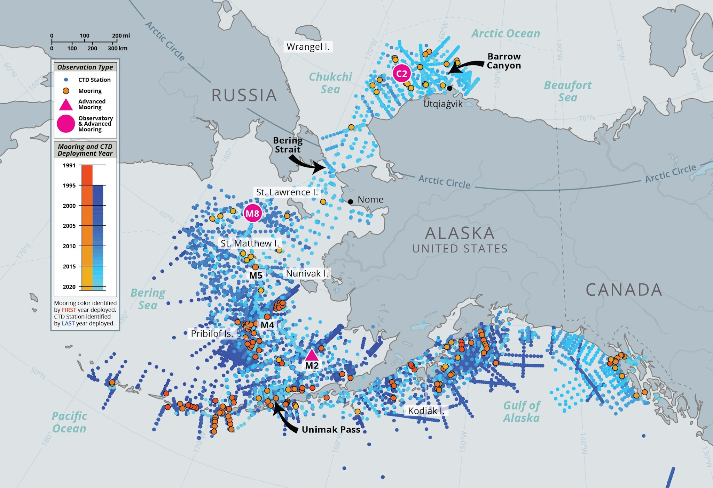



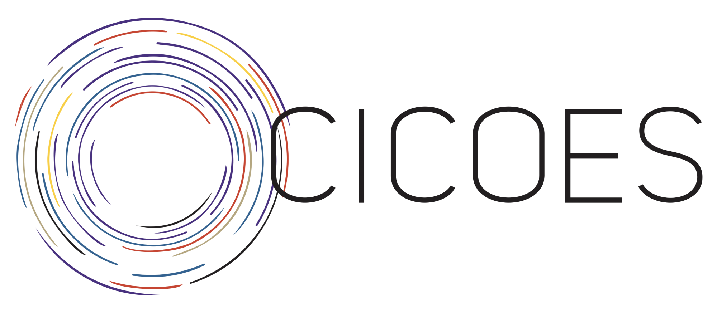

The Low Cost Profiler (LCP)
An affordable profiler to enable ocean science at scale
N.Lawrence¹, M. Casari², B.Martin¹, J.Kurina³
¹National Oceanic and Atmospheric Administration
²SeaMount Sensors & Automation, Waterbury, Vermont
³Cooperative Institute for Climate, Ocean, and Ecosystem Studies
PACIFIC MARINE ENVIRONMENTAL LAB | SEATTLE, WA
Notes:
Mechanical Engineer at PMEL, what we do = design build and operate large global observational arrays = moorings
LCP was kickstarted by PMEL’s ITAE program = Innovative Technology for Arctic Exploration = Lab level, high risk High reward technology development funding to meet NOAA’s future ocean observation needs (other projects included Oculus and Saildrone)

Slide 2
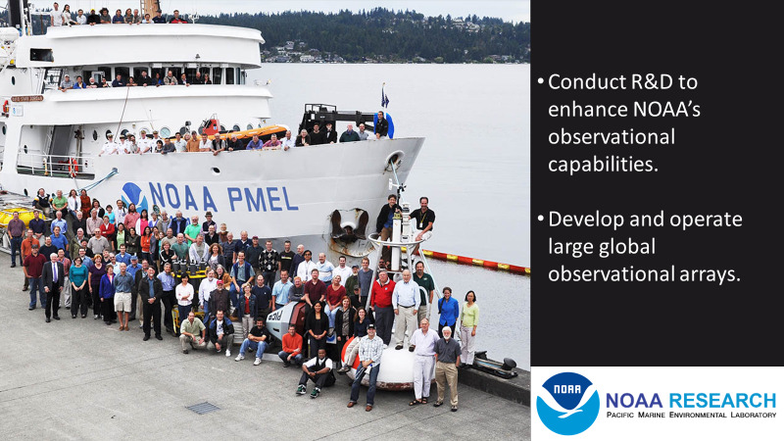
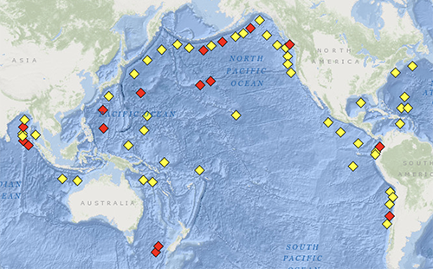

Slide 3
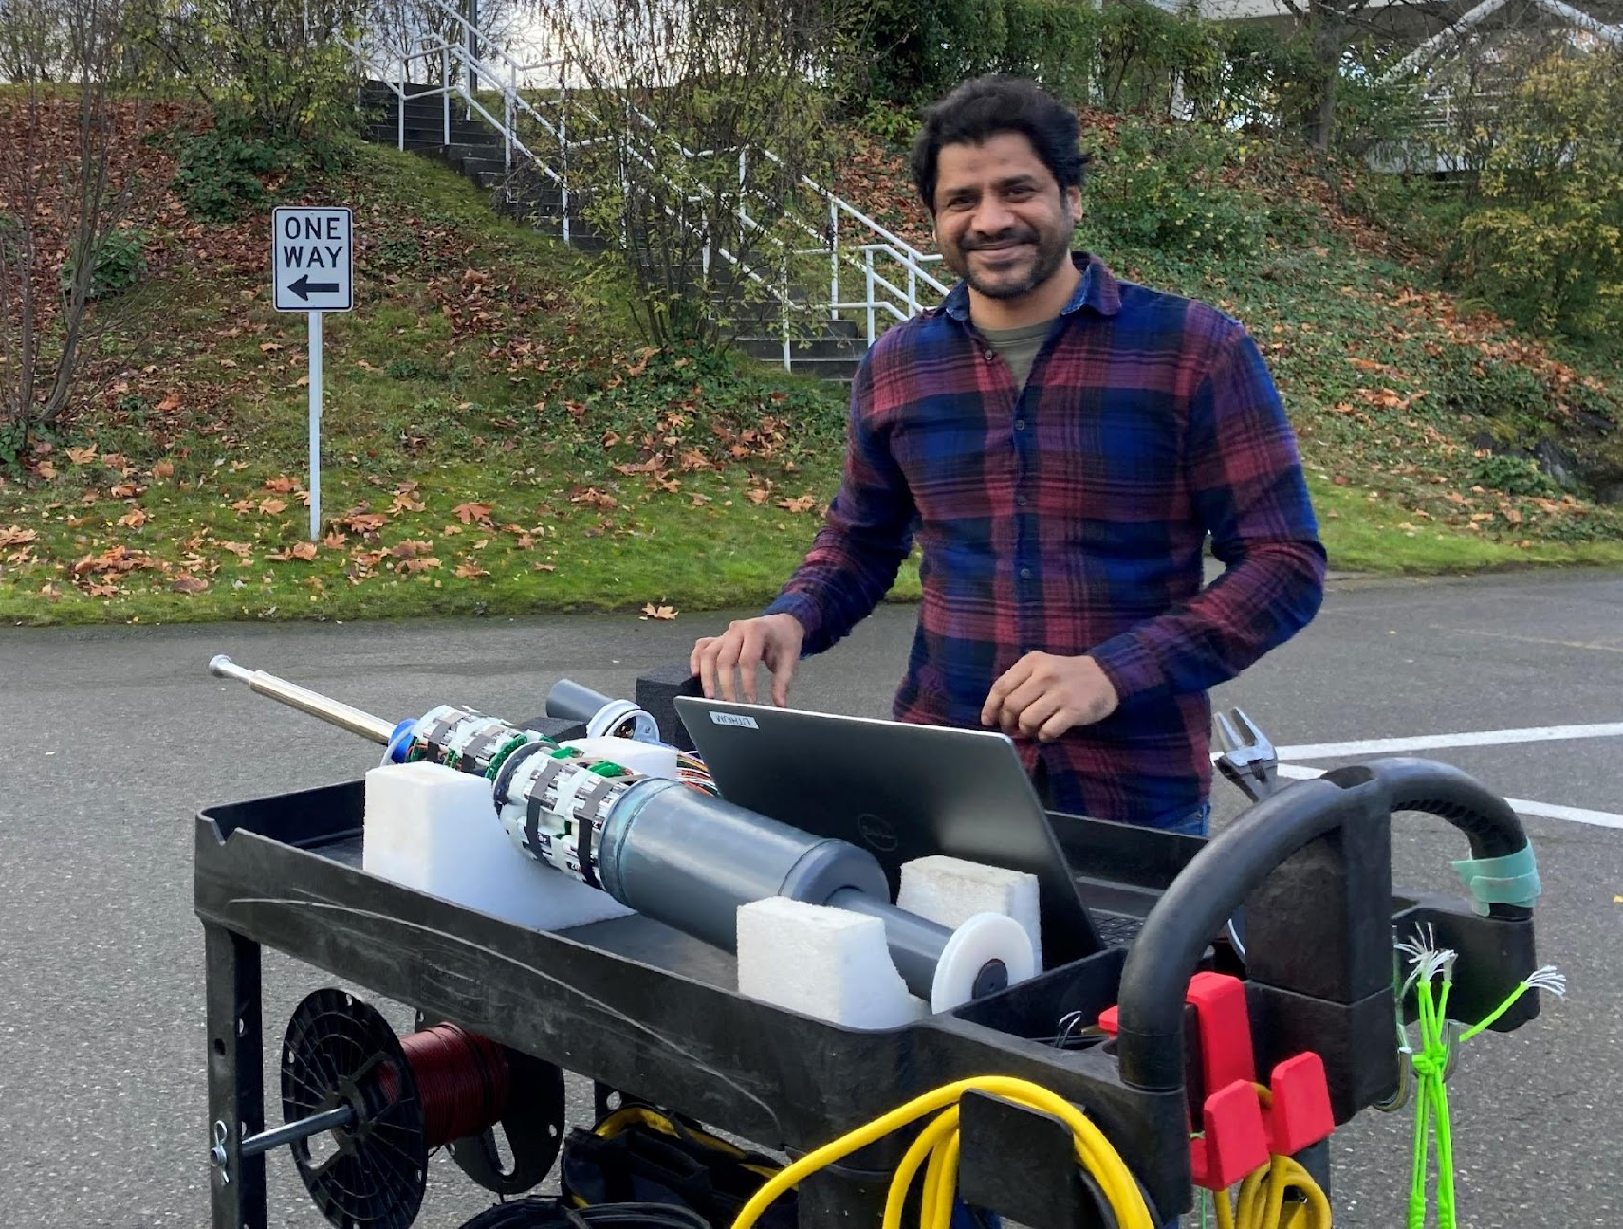
Ocean Observation Tech Development: LCP
LCP Product
Science Applications
Progress
Future Plans/Needs
Notes:
Quick rundown of this presentation

Slide 4
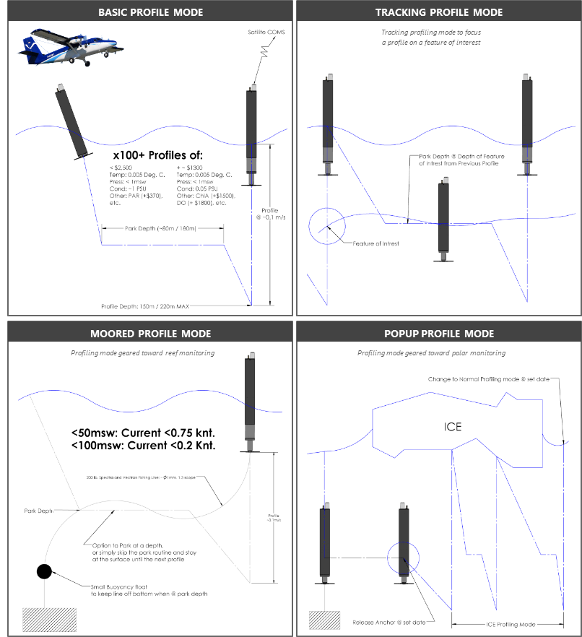
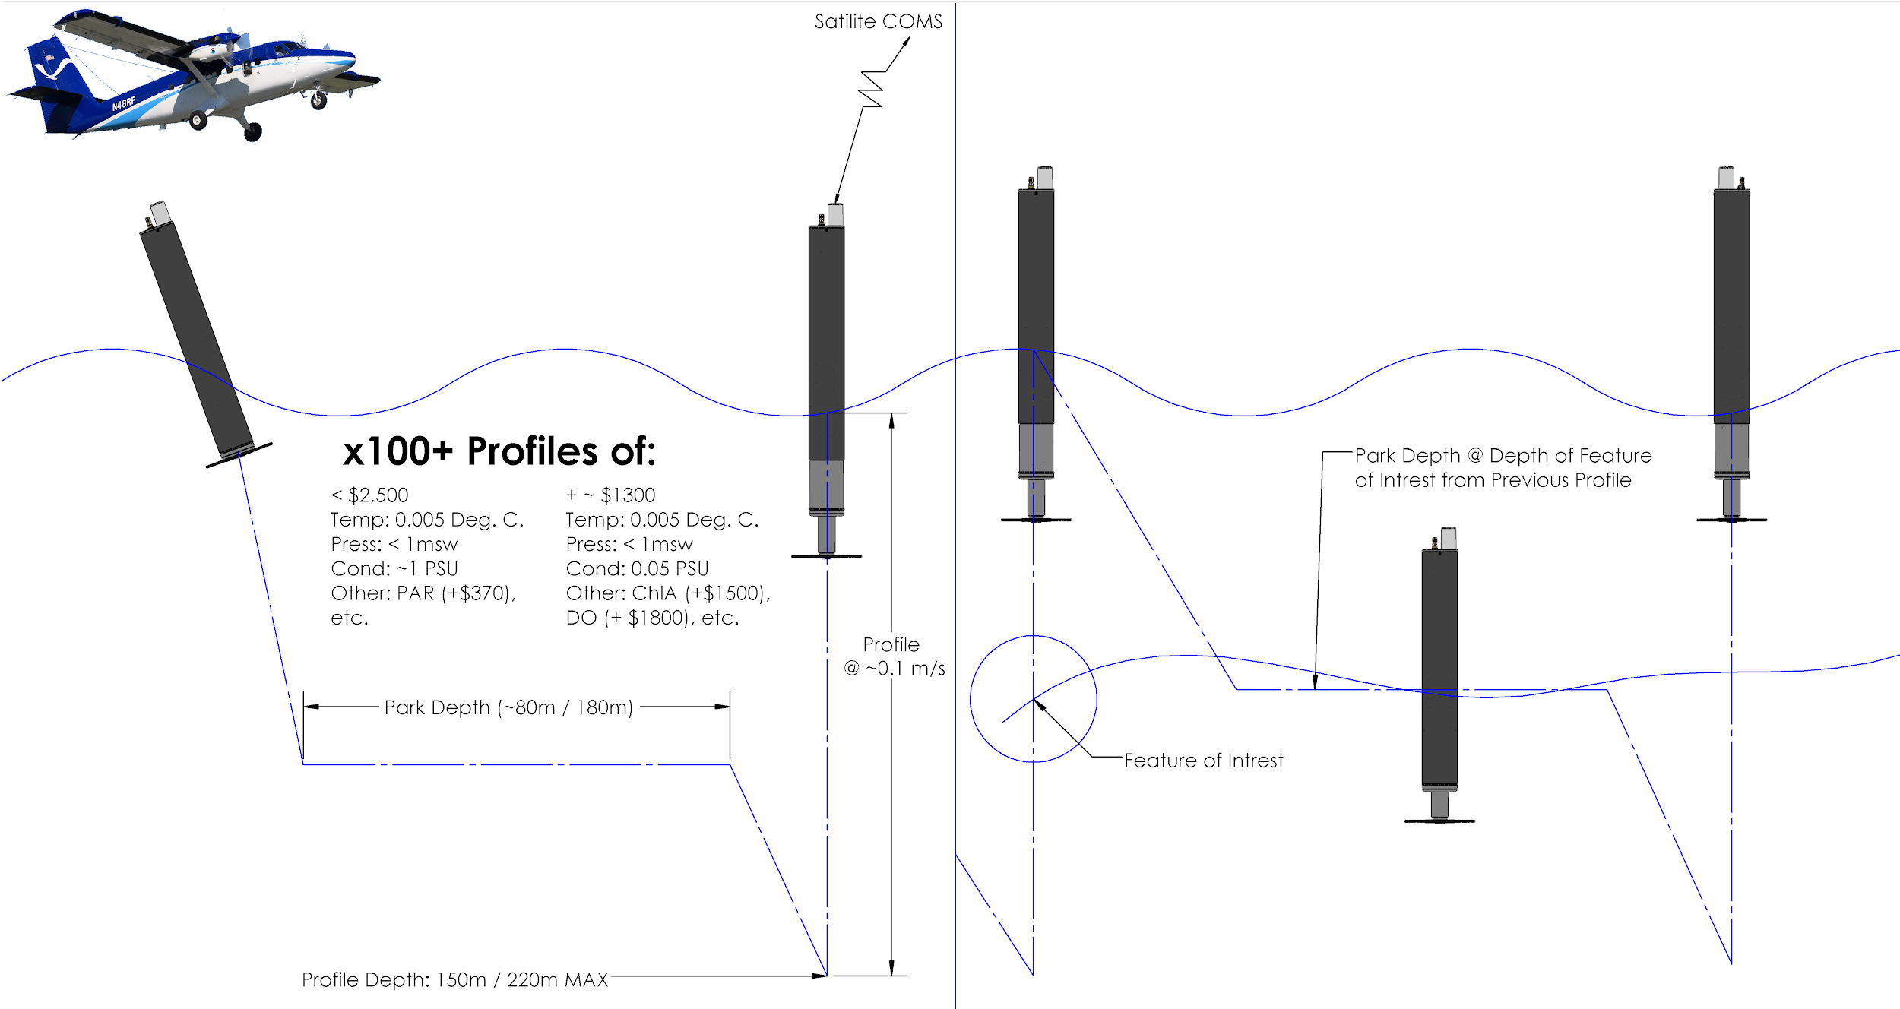
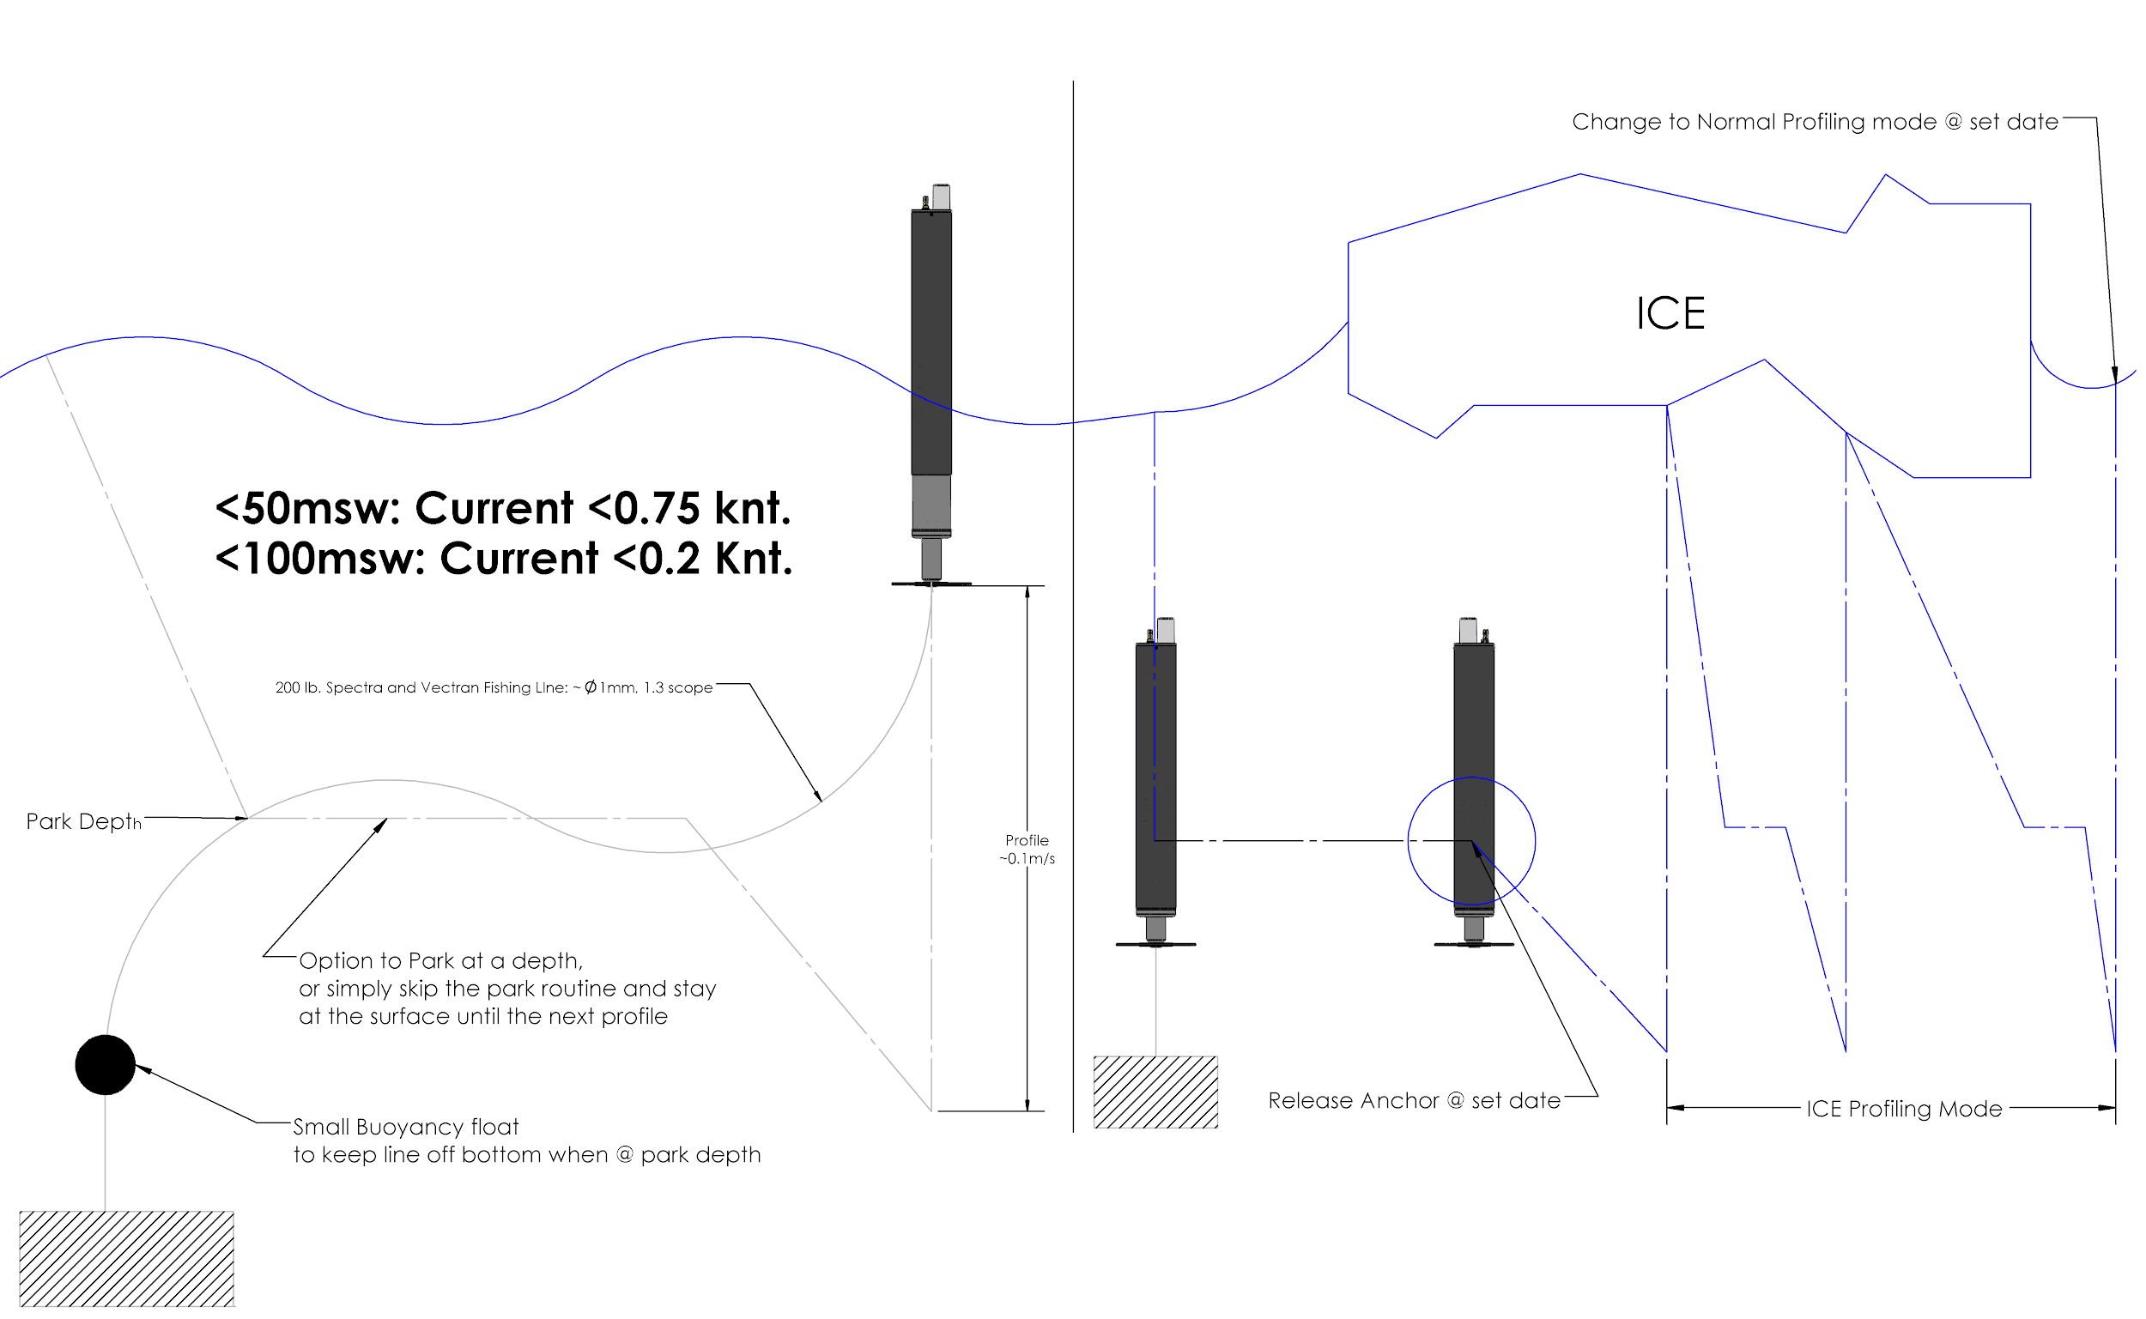
Low Cost Profiler (LCP):
BASIC PROFILE MODE
TRACKING PROFILE MODE
Cost | ~$5,000 (in QTYs of 10)
Maximum Depth | 220m
Endurance | 100 profiles (nominal)
Dimensions | 91.4 cm length x 12. 4 cm diameter
Weight | 13.6 kg
Telemetry | Iridium Short Burst Data (SBD) w/ more options available in future
Energy | Alkaline Battery Pack or Lithium
Features | Air deployable, Moorable
Sensors | Pressure: Keller 9LX-30Bar Temperature: S9 OEM Temp, RBRcoda* Conductivity:* S9 OEM CT, PMEL OEM, Aanderaa 5819 CHLA:* Turner Cyclops 7F PAR:* TAG-PARQ DO*: Aanderaa Optode 5730, PME microDOT
BASIC PROFILE MODE
TRACKING PROFILE MODE
Tracking profiling mode to focus a profile on a feature of interest
MOORED PROFILE MODE
POPUP PROFILE MODE
Profiling mode geared toward reef monitoring
Profiling mode geared toward polar monitoring
Notes:
PMEL has developed the LCP, goal is to make a profile for <30$, an order of magnitude less than current profiling floats.
Developed to be easily built, configured, and deployed by air, ship or hand.
Simple Design = the LCP uses a direct-drive buoyancy engine to reduce mechanical complexity
Geared towards community involvement in sensor integration, goal is to bring your own sensor to an open source design that can be purchased from a contract manufacturer
The LCP can be configured pre-mission to perform in different observational roles, including drifting, timed release and moored, making it a unique tool for autonomously profiling the upper 200m of a water body.

Slide 5
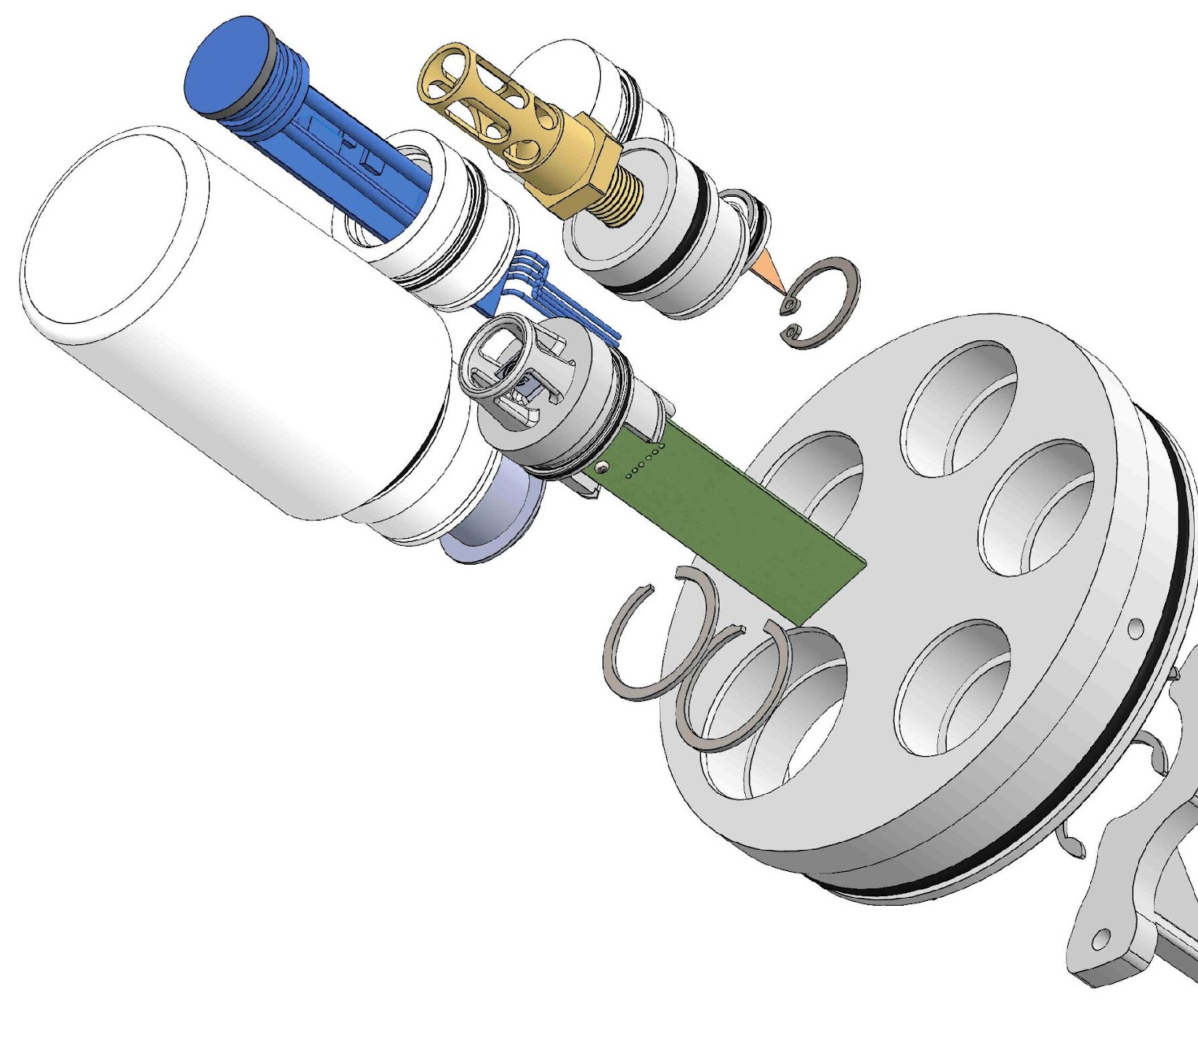
Low Cost Profiler (LCP): Sensors & Peripherals
OEM calibrated sensors
5 universal sensor ports
Climate Quality
Temperature
Pressure
‘Weather’ Quality
Conductivity
CHL-A
PAR
DO
Iridium SBD Communications
Notes:
Key to reducing costs is using OEM manufacturer calibrated sensors

Slide 6
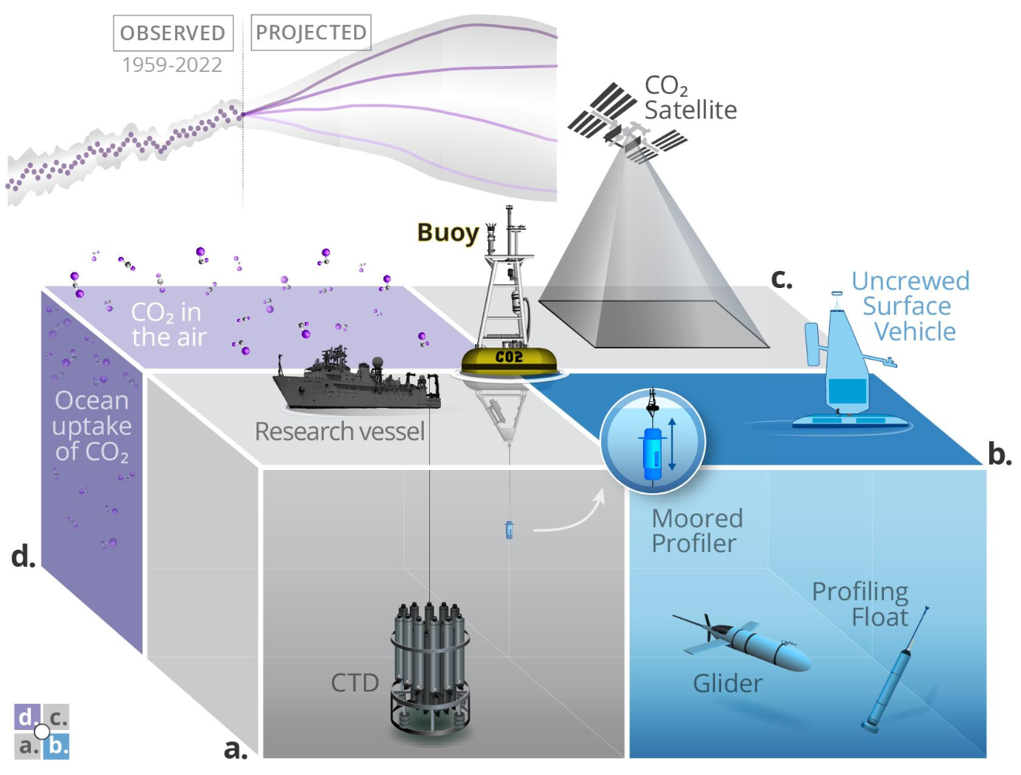
LCP: Science Driven Applications
LCP Fills Gaps in Observational Arrays
Hurricane Intensity
Bering Sea Fisheries
Arctic HABs and Ice
Coastal & Coral Reef Monitoring
ONR Profiling CTD BAA
Graphic Courtesy of Adrienne Sutton
Notes:
Observation challenge = work to do to reduce the uncertainty in our predictive capability = opportunity for technology innovation in our flat funded world!
In response to this challenge, NOAA-PMEL is exploring innovative methods to quickly propagate and support high quality, low cost, tools throughout our community.
Requires the development of fit-for-purpose tools to fill gaps in our traditional observational array
LCP Solution =
Multi-mission capable = capitalize on economies of scale.
Keep costs low to allow for risk taking and rapidly scale in situ observations
Sensors are very expensive = make profiles
Profiling floats have proven successful at covering large volumes, ARGO like…. but much cheaper
Relevance & Application Examples: LCP has wide applicability to many NOAA R&D vision areas and the 2026 strategic research guidance memorandum
Vision Area 1: Hazardous and Extreme Weather = Hurricane Intensity
Vision Area 2: Sustainable fisheries
SRGM: improve coverage of observations = gap filling & Arctic & HAB
Here are a few we are actively pursuing that address , others? Let’s talk = rely on word of mouth for tech dissemination.

Slide 7
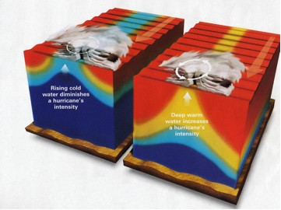
LCP: Hurricane Application
GOAL: Subsurface ocean temperature and salinity measurements are needed ahead of and underneath hurricanes to:
Initialize coupled forecast models
Improve mixing parameterizations in models
Aid forecaster situational awareness
Improve understanding of hurricane air-sea interaction processes
Existing Technology:
ALAMO Float = Expensive: ~$400K for 16 floats deployed ahead of Hurricanes Irma and Florence
AxBT & AxCTD = Less expensive (~$1000) but only gives one temperature or CTD profile
Partner: AOML (Jun Zhang, Greg Foltz)
Credit: National Geographic
Notes:
Hurricanes intensify by drawing heat energy from the ocean, Strong ocean mixing by a hurricane’s winds brings cooler water to the surface, decreasing the heat energy available to the hurricane
Air deployable LCP application

Slide 8
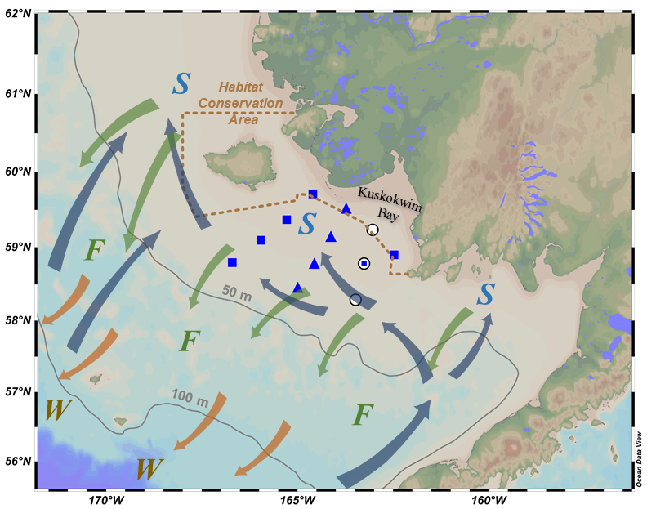
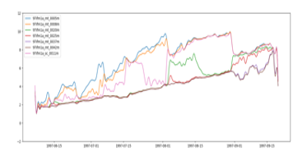

LCP: Fisheries Application
GOAL: Improve understanding of regional oceanography and support fishing industry with tools that may reduce halibut bycatch
Need understand the connection between surface temperature and bottom temperature in the Kuskokwim Bay area, so that we may be able to use remotely-sensed surface temperature to predict real-time bottom temperature.
Partner: PMEL-ECOFOCI (Phyllis Stabeno, Calvin Mordy)
Predicting these bottom temperatures is difficult!
Measuring bottom temperature with LCP will support fishing industry
Notes:
Improve understanding of regional oceanography and (2) support fishing industry with predictive tools that may help reduce halibut bycatch
Yellowfin sole arrive earlier in colder water than halibut. To avoid halibut bi-catch it is necessary to predict (or measure) bottom temperatures. Allowing fishing vessels to arrive at fishing grounds when bottom temperatures are more optimal for yellowfin sole and less optimal halibut
Application for moored LCP, will trial this technology in Fall 2025
S = Spring when Yellowfin arrive on the inner shelf while temps are too cold for halibut. As things warm the fleet needs to move to colder water to avoid catching the halibut. Yellowfin move to deeper water if fall (F) and winter (W)

Slide 9
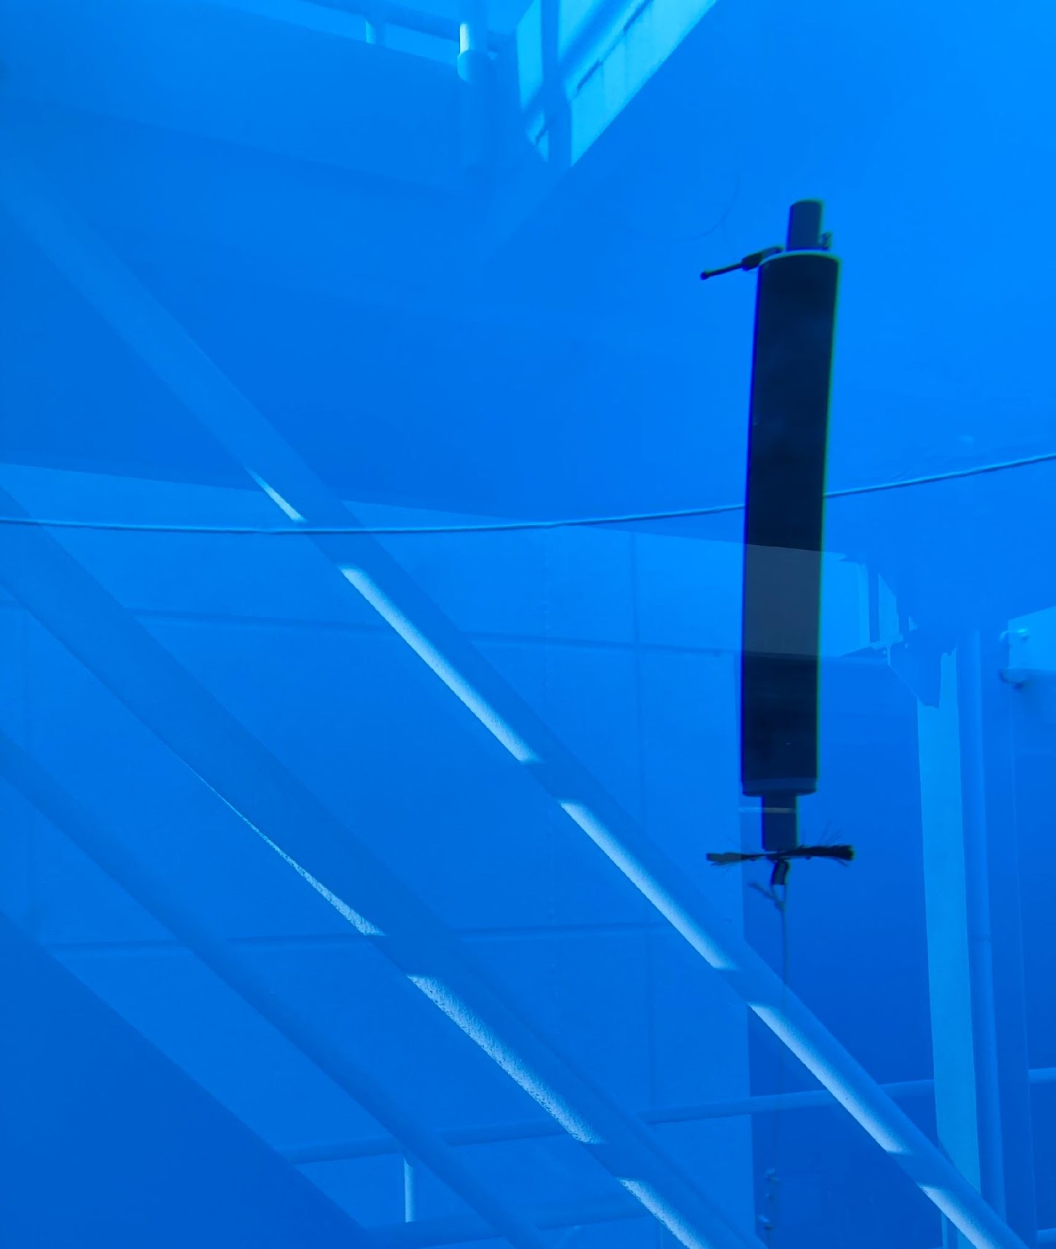
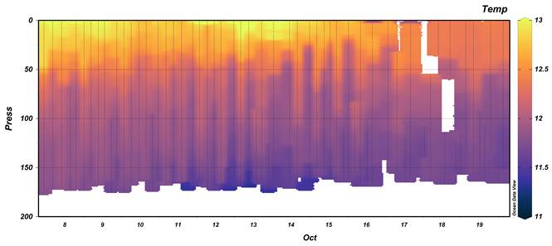
Low Cost Profiler: Current Status
Complete:
mechanical stress testing.
functional testing in tank.
Hand-deployed at RL5
Now:
5x field deployments moored in Puget Sound, WA.
Completed 100 profiles to 170m.
Next Steps:
Secure stage 2 funding
CTD Sensor Integration
Air Deployment- ONR BAA
Open Source approach
Notes:
Design is proven in PMEL pressure vessel and NOAA Dive Tower
Moored in Puget Sound
Next Steps = Secure funding for 2 focus areas for continued LCP tech development

Slide 10
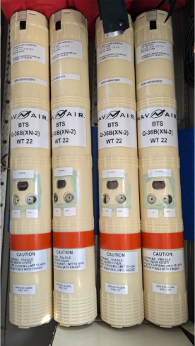
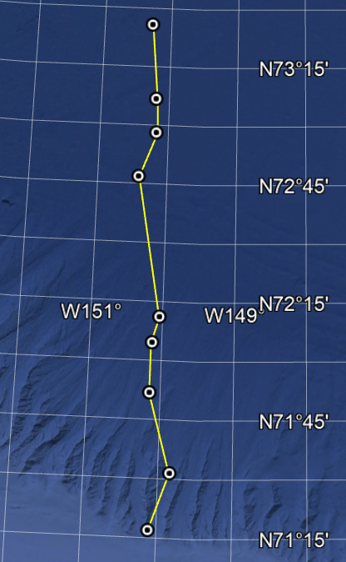
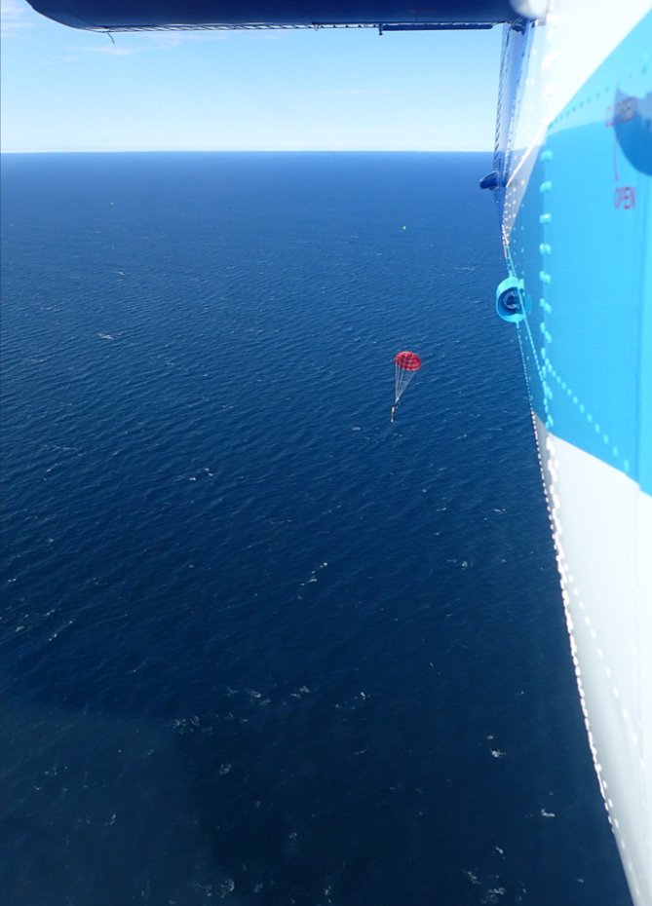
LCP expands work in the Beaufort Sea
LCP: Arctic Sea Ice Application
Arctic AIR (Jiaxu Zhang, UW-CICOES) focuses on stratification mechanisms in the southern Beaufort Sea and their impact on sea ice formation/melt and phytoplankton growth.
Previously, we relied on AxCTDs and ALAMO floats for this data, but LCP offers a more cost-effective alternative for measuring salinity-driven stratification.
2024 AxBT deployment along 150W
An ALAMO drifting down from Twin Otter

Slide 11
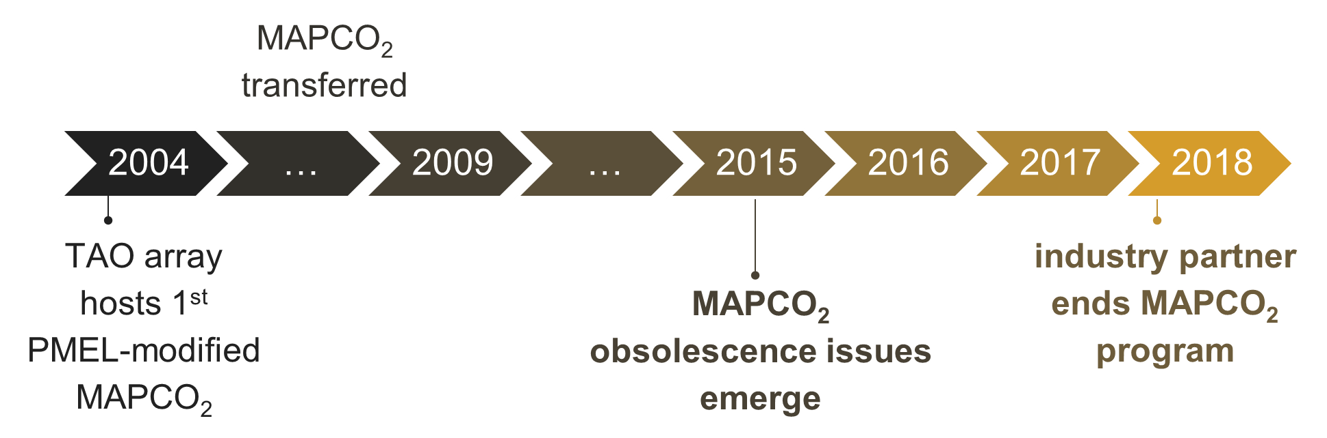
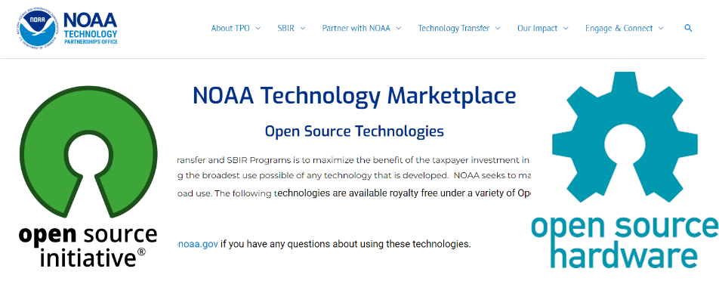
Open Source Solution:
Societal implications of ocean change ≠ capacity of ocean technology development community
Use: Provide truly low-cost tool
Scale: Contract manufacturer approach to building in quantities
Sustain: Industry and users can assist in system upgrades, sensor integration…..
Notes:
Use LCP as a pilot for Open Source approach
Tool is not very useful if it is not available, how do we rapidly get the LCP technology into the hands of the broader scientific community?
Problem= Ocean observing technology development life cycles are too long!
Problem= Traditional commercialization path can result in expensive products that receive inadequate sustained development support
Problem = Sole source single points of failure =products often dropped due to lack of adequate commercial sales
Have been working with NOAA’s Tech Partnership office to:
Generate open source hardware license
Develop an open source technology transfer pathway in NOAA
Obtain permission to open source
MBARI has had a lot of luck with contract manufacturers producing complicated ocean sensors (pH), could be a solution to providing community with a source, this is what they are good at. Community ecosystem could then provide buying power, functionality upgrades
Risk = Do not know if it will work.

Slide 12
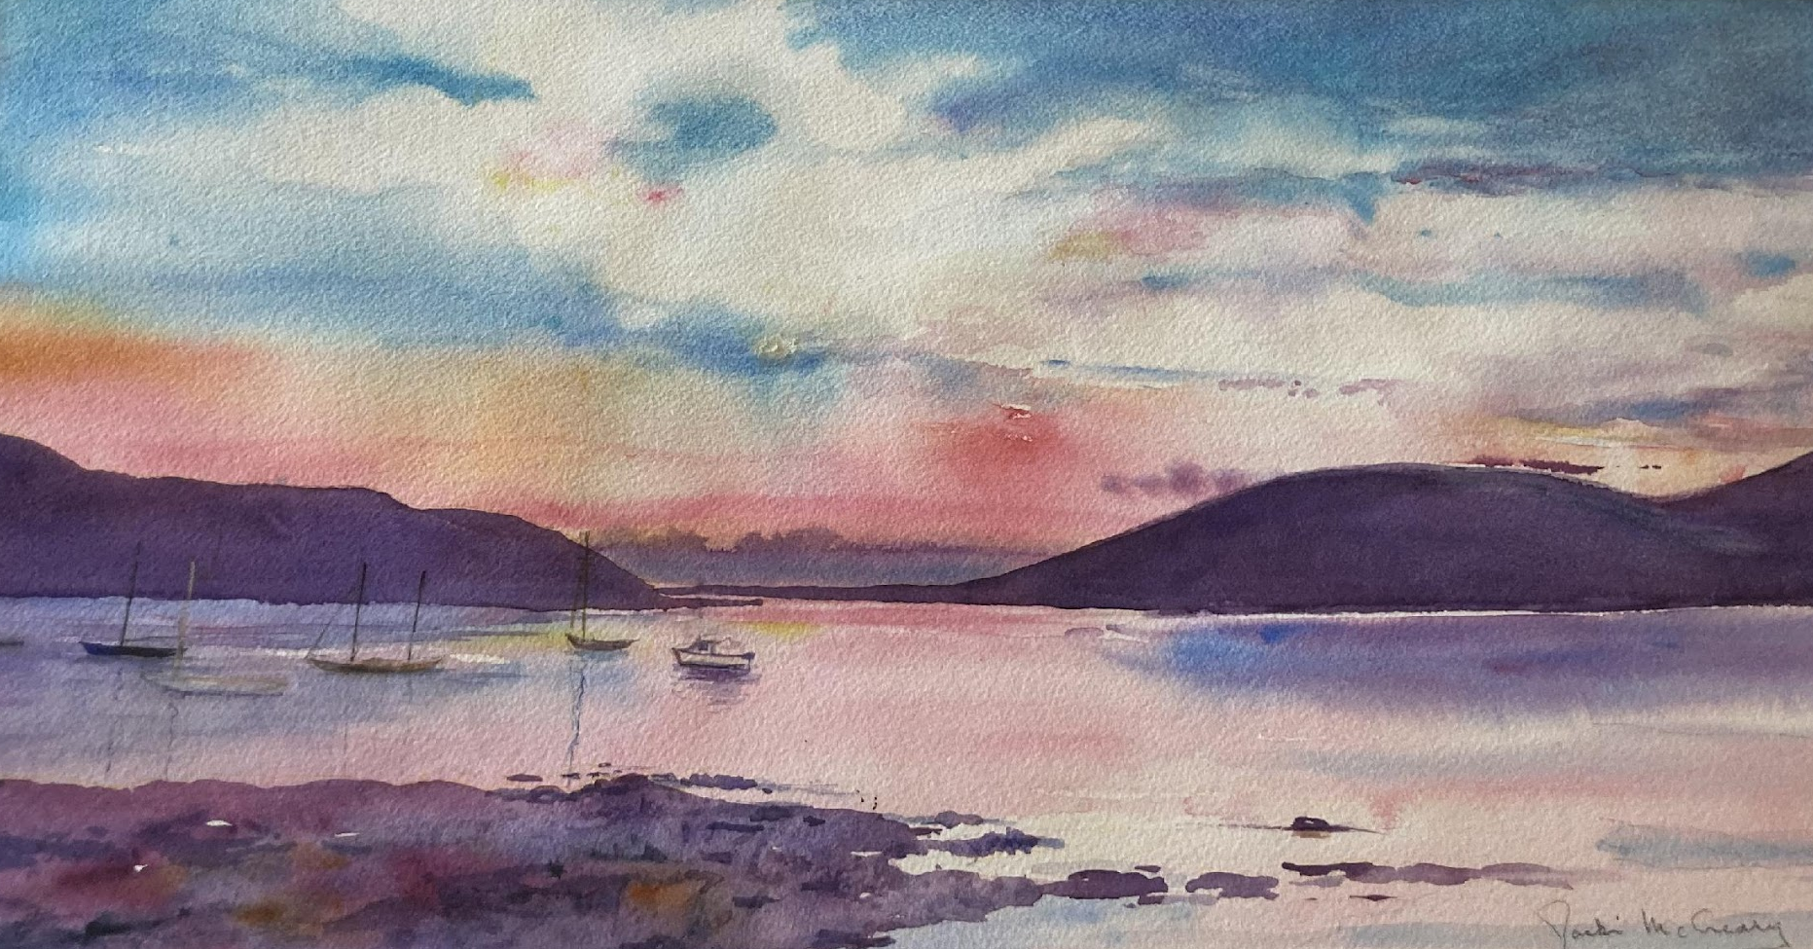
Thank You
Notes:
Thank you!

Slide 13
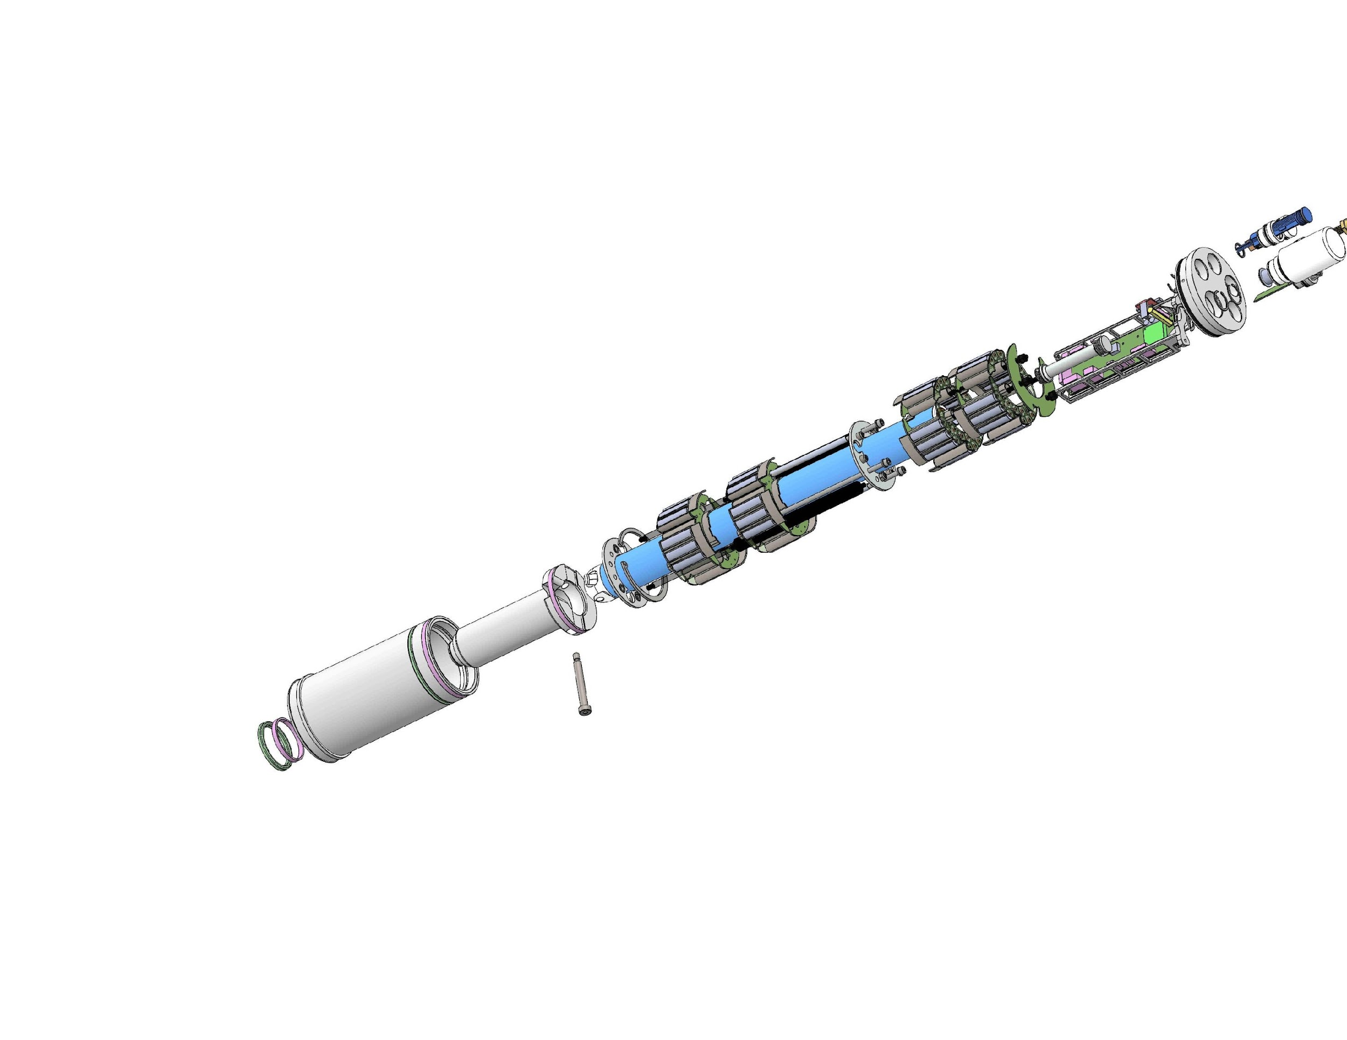
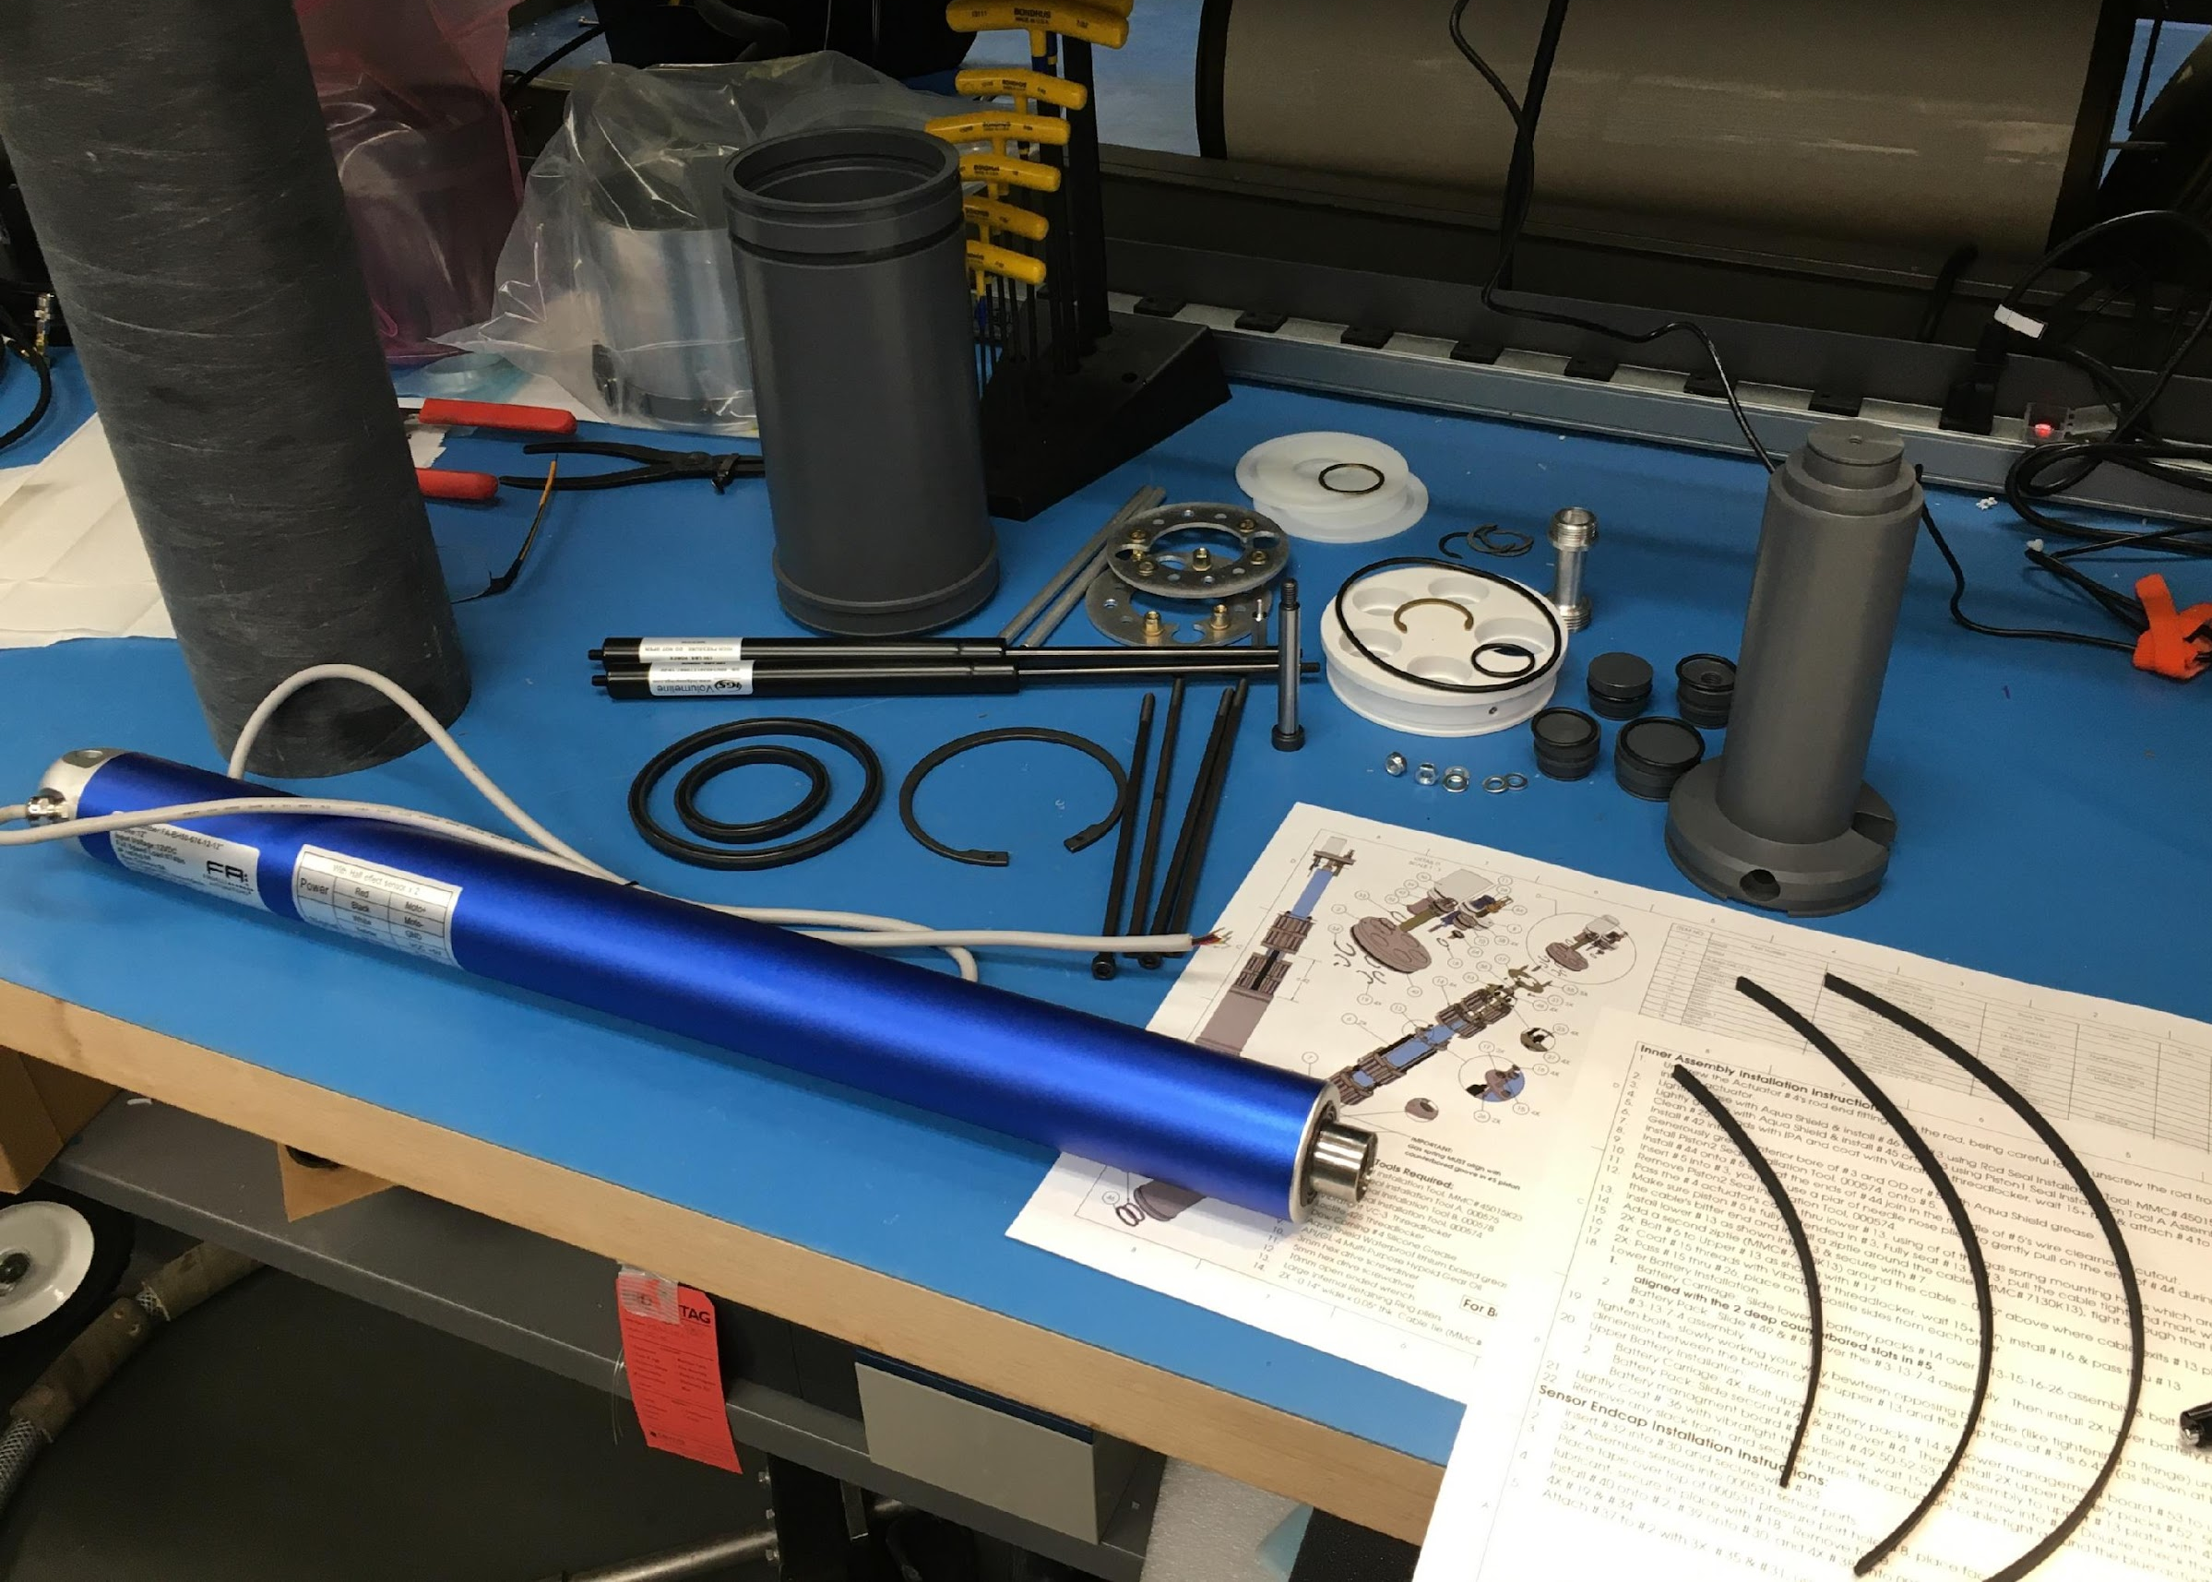
Low Cost Profiler (LCP): Design
Simple direct drive buoyancy engine
Maximizes OEM components
Minimizes custom components
Notes:
The LCP uses a direct-drive buoyancy engine to reduce mechanical complexity
And a commodity pressure housing taken from the industrial pneumatics industry

Slide 14
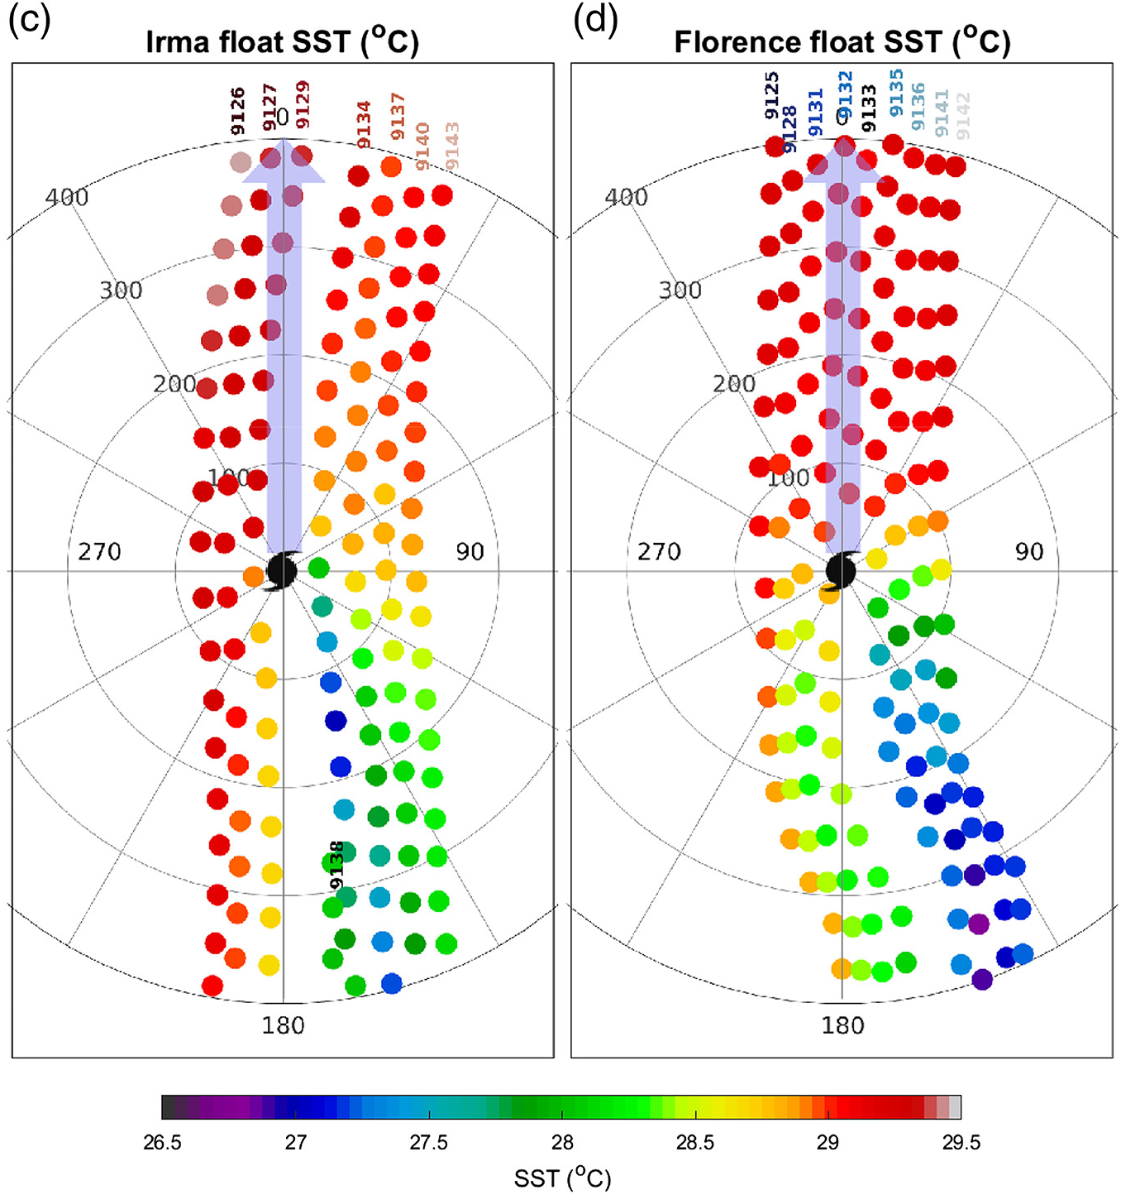
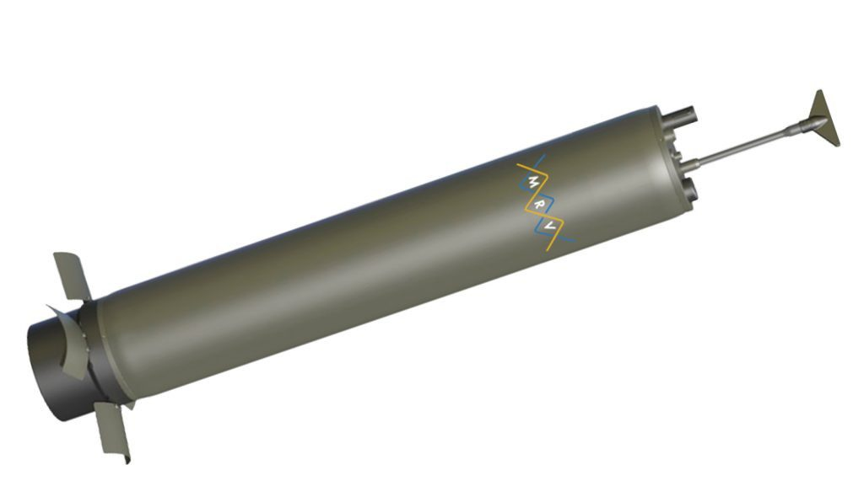
ALAMO floats
Deployed ahead of hurricanes by aircraft
Can profile every 2 hours to 300 m for several months
Expensive: ~$400K for 16 floats deployed ahead of Hurricanes Irma and Florence
Sanabia and Jayne (2020)
Notes:
First row of colored circles indicates float deployment locations. Subsequent circles show surfacing locations of the floats, with colors indicating measured SST as the hurricane passed.

Slide 15
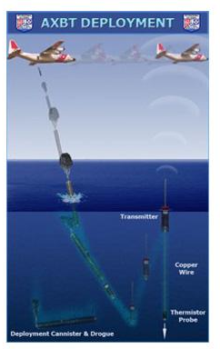
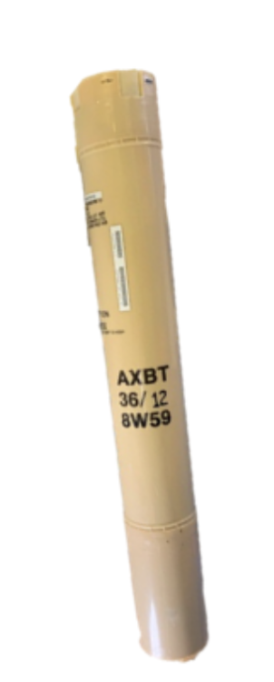
AXBTs
Deployed ahead of hurricanes by aircraft
Floats on surface, releases thermistor probe that measures temperature as it drops
Less expensive (~$1000) but only gives one temperature profile
AXCTDs also measure salinity but are more expensive
Credit: U.S. Coast Guard

Slide 16
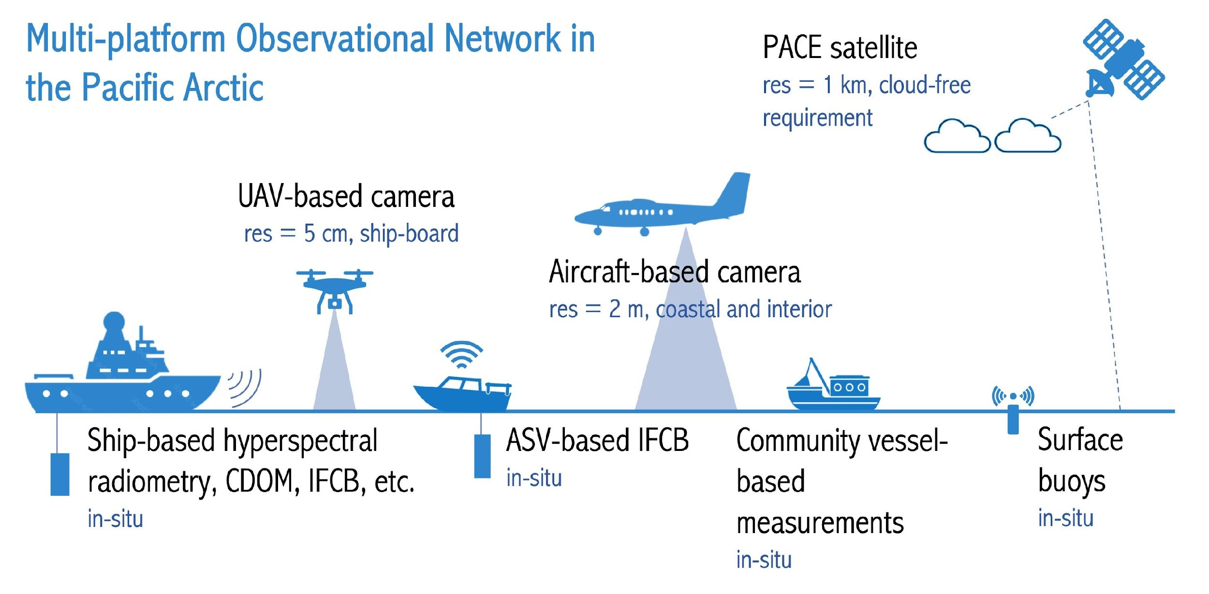
LCP adds an additional platform for HAB monitoring
LCP: HAB Application
Arctic AIR (Jiaxu Zhang, UW-CICOES) and collaborators are developing a multi-platform phytoplankton monitoring system to enable early warning of harmful algal blooms (HABs) in the Pacific Arctic.
LCP with additional light and biological sensors (e.g, PAR, Chl-a) will greatly enhance data collection and help us better understand biophysical interactions and primary production.
LCP

